Slide 1

Triangle Counting
Yuval Alfassi

Slide 2
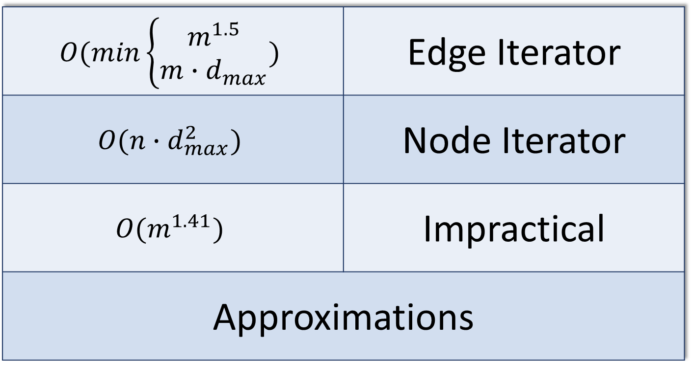
Triangle Counting – Static Centralized
$$O(min\left\{\begin{aligned}m^{1.5} \\ m∙d_{max}\end{aligned}\right.)$$ | Edge Iterator
$$O(n∙d_{max}^{2})$$ | Node Iterator
$$O(m^{1.41})$$ | Impractical
Approximations

Slide 3
Incremental – Dynamic central approximation
# of triangles
approximation
$(ε,δ)$ approximation
(𝝐,𝜹) approximation
$$O\left(\frac{\log{n}}{ε^{2}α}\log{\frac{1}{δ}}\right)$$
$$expected time$$
𝑶(𝐥𝐨𝐠⁡𝒏/(𝝐^𝟐 𝜶) 𝐥𝐨𝐠⁡〖𝟏/𝜹〗 )
𝒆𝒙𝒑𝒆𝒄𝒕𝒆𝒅 𝒕𝒊𝒎𝒆
$$O\left(\frac{\log^{2}{n}}{ε^{2}α}\log{\frac{1}{δ}}\right)$$
$$worst case time$$
𝑶(〖𝐥𝐨𝐠〗^𝟐⁡𝒏/(𝝐^𝟐 𝜶) 𝐥𝐨𝐠⁡〖𝟏/𝜹〗 )
𝒘𝒐𝒓𝒔𝒕 𝒄𝒂𝒔𝒆 𝒕𝒊𝒎𝒆

Slide 4
Triangle Counting – Dynamic Centralized
‘Trivial’ Solution
$$O\left(d_{max}\right)$$
per update
𝑶(𝒅_𝒎𝒂𝒙 )
per update
$$O\left(1\right)$$
edge existence
𝐎(𝟏)
edge existence
Adjacency Matrix
$O\left(n^{2}\right)$space
Adjacency Matrix
𝑶(𝒏^𝟐 ) space
Perfect
Hashing
probabilistic
complexity

Slide 5
Dynamic + Centralized + Persistent
$$O\left(d_{max}∙log (n)\right)$$
per update
𝑂(d_max∙log (𝑛))
per update
Automatic vertex addition
Fully functional –
Supports persistency

Slide 6
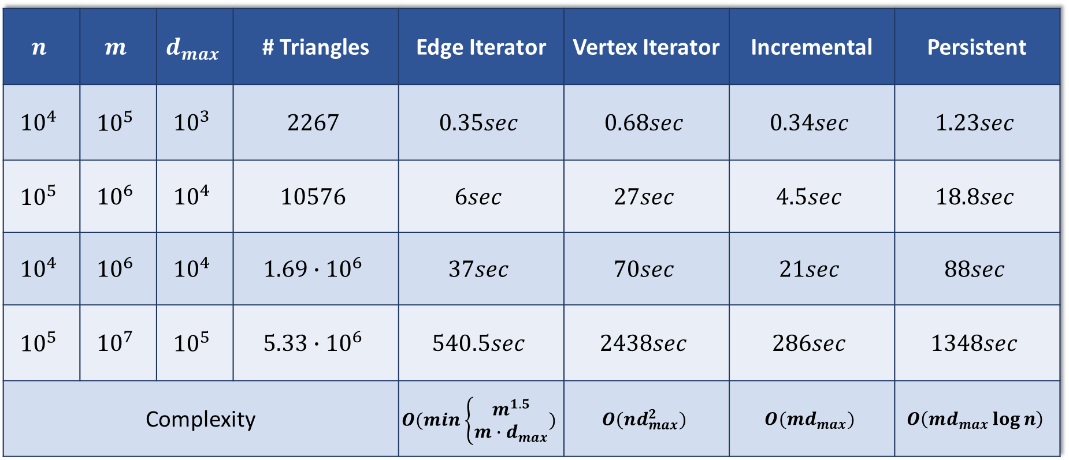
Performance Results
$$n$$ | $$m$$ | $$d_{max}$$ | # Triangles | Edge Iterator | Vertex Iterator | Incremental | Persistent
$${10}^{4}$$ | $${10}^{5}$$ | $${10}^{3}$$ | $$2267$$ | $$0.35sec$$ | $$0.68sec$$ | $$0.34sec$$ | $$1.23sec$$
$${10}^{5}$$ | $${10}^{6}$$ | $${10}^{4}$$ | $$10576$$ | $$6sec$$ | $$27sec$$ | $$4.5sec$$ | $$18.8sec$$
$${10}^{4}$$ | $${10}^{6}$$ | $${10}^{4}$$ | $$1.69∙{10}^{6}$$ | $$37sec$$ | $$70sec$$ | $$21sec$$ | $$88sec$$
$${10}^{5}$$ | $${10}^{7}$$ | $${10}^{5}$$ | $$5.33∙{10}^{6}$$ | $$540.5sec$$ | $$2438sec$$ | $$286sec$$ | $$1348sec$$
Complexity |  |  |  | $$O(min\left\{\begin{aligned}m^{1.5} \\ m∙d_{max}\end{aligned}\right.)$$ | $$O(nd_{max}^{2})$$ | $$O(md_{max})$$ | $$O\left(md_{max}\log{n}\right)$$

Slide 7
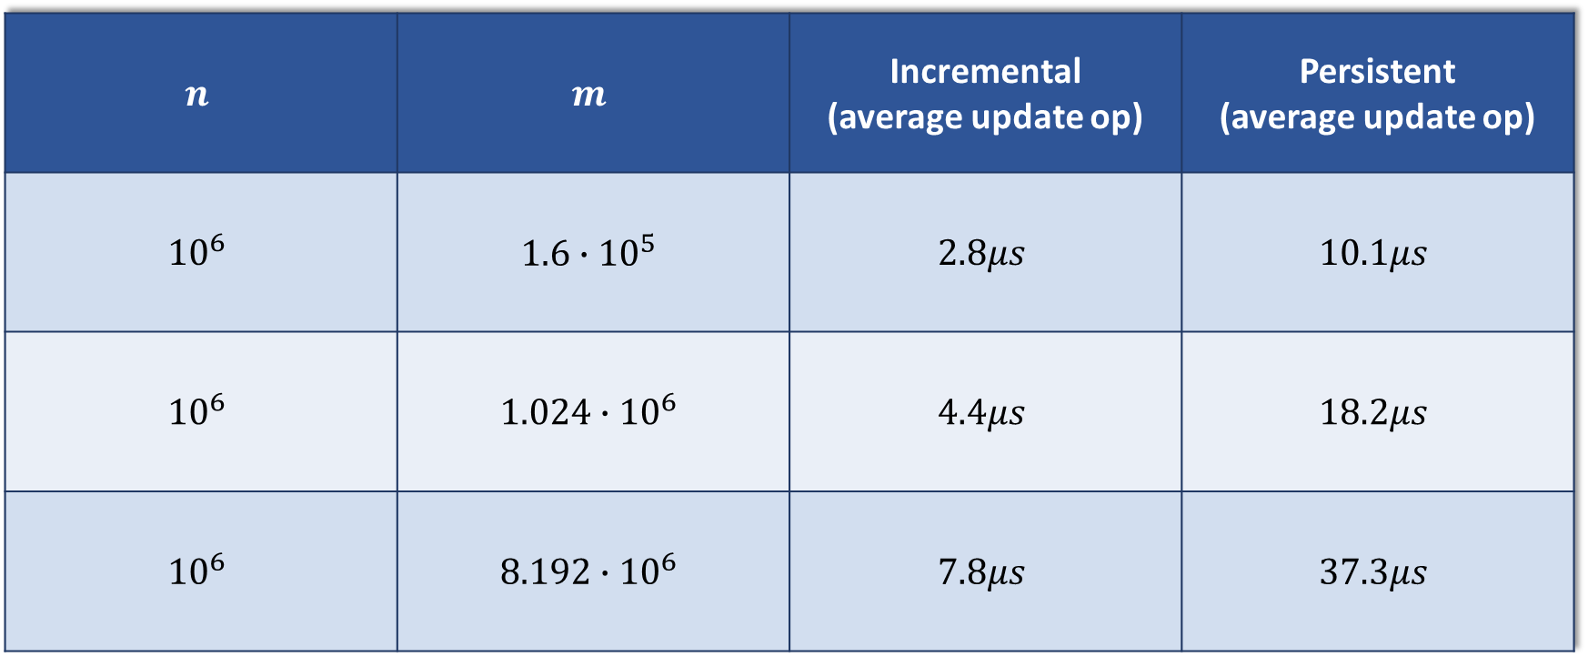
Performance Results
$$n$$ | $$m$$ | Incremental (average update op) | Persistent (average update op)
$${10}^{6}$$ | $$1.6∙{10}^{5}$$ | $$2.8μs$$ | $$10.1μs$$
$${10}^{6}$$ | $$1.024∙{10}^{6}$$ | $$4.4μs$$ | $$18.2μs$$
$${10}^{6}$$ | $$8.192∙{10}^{6}$$ | $$7.8μs$$ | $$37.3μs$$

Slide 8
Performance Results

Slide 9

Persistency explained

Slide 10
Persistency explained
3
8
-1
4
-2

Slide 11
Persistency explained
5
3
8
-1
4
-2

Slide 12
Persistency explained
5
3
8
-1
4
-2
5
7

Slide 13
Persistency explained
5
3
8
-1
4
-2
5
7

Slide 14
Persistency explained
7
3
10
1
5
9
13

Slide 15
Persistency explained
7
6
3
10
1
5
9
13

Slide 16
Persistency explained
7
6
6
3
10
12
1
5
9
13

Slide 17
Persistency explained
7
6
6
3
10
12
1
5
9
13

Slide 18
Persistency explained
7
6
6
3
10
12
1
5
9
13

Slide 19

Persistency explained

Slide 20
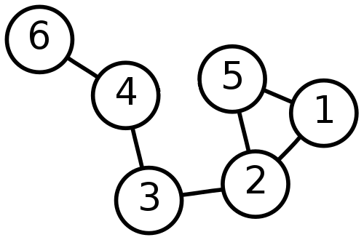

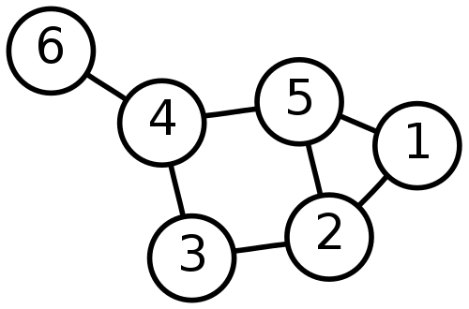
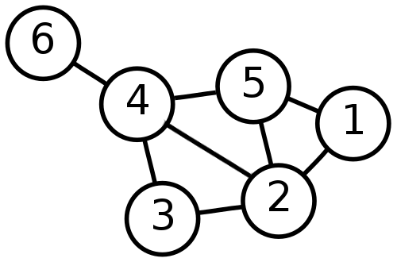
Graph Persistency

Slide 21
Thank You!

